Slide 1

ICT 502 Internet and Web Development
Week 4 Lecture & Tutorial
Introduction to CSS
Lecturer: Dr. Farshid Keivanian
TEQSA: PRV14311 CRICOS: 03836J

Slide 2
Welcome to lecture week 4, where we dive into the world of web development with a detailed exploration of Cascading Style Sheets (CSS). This session focuses on the foundational aspects of CSS including syntax, styles, and selectors, and how they can be applied to enhance the presentation of web pages. The lecture discusses the significance of the CSS box model, which is a crucial concept for understanding the layout of HTML elements, and text styling, which is key for creating visually engaging content. The practical component of the lecture is designed to solidify these concepts through hands-on examples, ranging from simple color and font assignments to more complex applications involving the box model and background properties. By the end of the tutorial, students are expected to demonstrate their understanding by crafting a personalized web profile, applying internal, external, and inline CSS for various selectors, cementing their grasp on web development's visual side.

Slide 3
Week 4
Lecture content and Examples 1 to 7
What is CSS?
CSS Syntax
Location of Styles
Selectors
The Box Model
CSS Text Styling
Attendance & Multiple-choice Questions - Recognising student participation and engagement specifically identifying those who are most actively involved!
Tutorial/Weekly lab

Slide 4
CSS Syntax
A CSS document consists of one or more style rules.
A rule consists of a selector that identifies the HTML element or elements that will be affected, followed by a series of property and value pairs (each pair is also called a declaration).

Slide 5
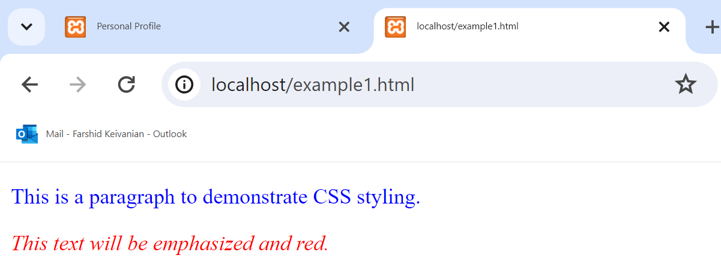
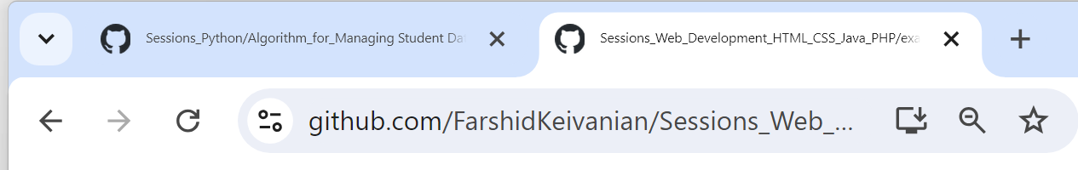
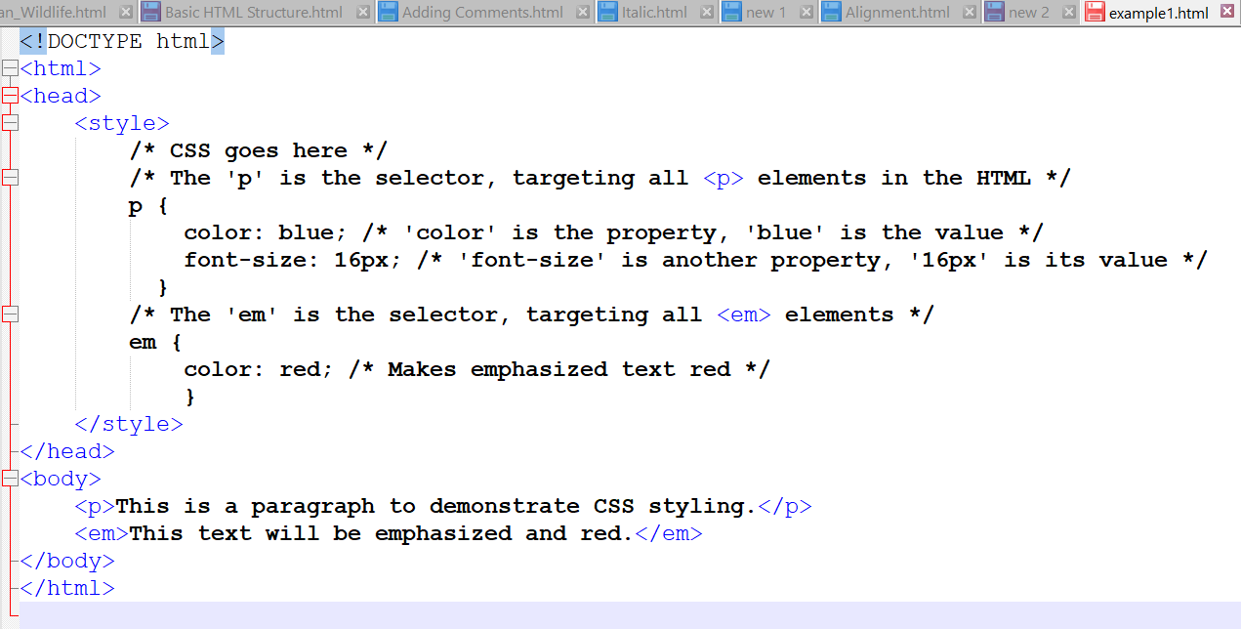
Example 1:
The code is available on Github
This example shows how to use CSS to style p and em elements, using color and font-size properties. The p elements will have blue text of size 16 pixels, and the em elements will have red text.

Slide 6
Example 1:
The <em> tag in HTML is used to emphasize text, which by default is displayed as italicized by most browsers. That's why the text within <em> tags appears italic on the webpage.

Slide 7
Declaration Blocks
The series of declarations is also called the declaration block.
A declaration block can be together on a single line, or spread across multiple lines.
The browser ignores white space
Each declaration is terminated with a semicolon.

Slide 8
Properties
Each individual CSS declaration must contain a property.
These property names are predefined by the CSS standard.

Slide 9
Properties
Property Type | Property
Fonts | font font-family font-size font-style font-weight @font-face
Text | letter-spacing line-height text-align text-decoration text-indent

Slide 10
Properties
Property Type | Property
Color and background | background background-color background-image background-position background-repeat color
Borders | border border-color border-width border-style border-top border-top-color border-top-width etc

Slide 11
Properties
Property Type | Property
Spacing | padding padding-bottom, padding-left, padding-right, padding-top margin margin-bottom, margin-left, margin-right, margin-top
Sizing | height max-height max-width min-height min-width width

Slide 12
Properties
Layout | bottom, left, right, top clear display float overflow position visibility z-index
Lists | list-style list-style-image list-style-type

Slide 13
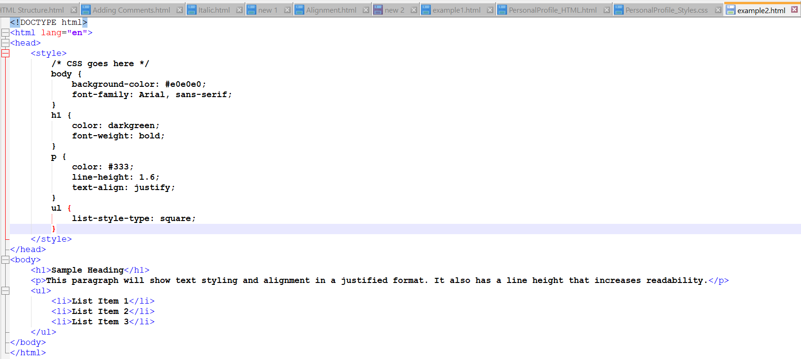
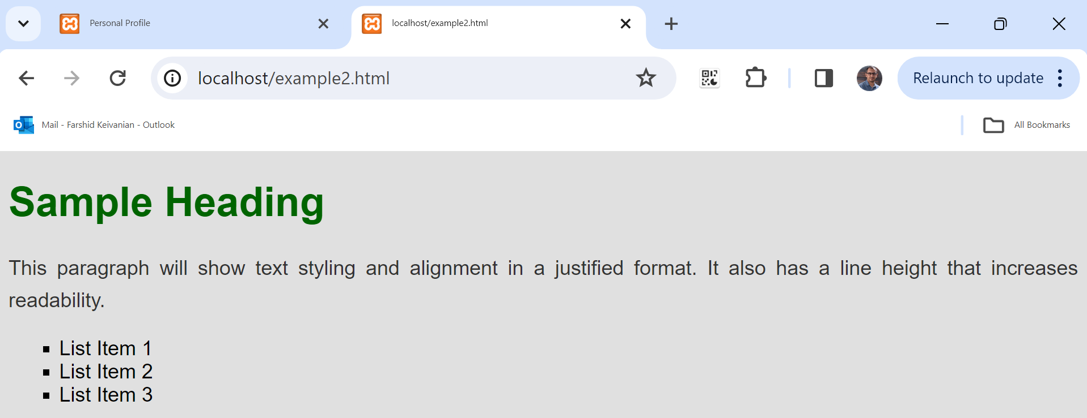
Example 2:

Slide 14
Example 2:
This code will produce a simple webpage with a light grey background, a bold green heading, a dark grey justified paragraph with increased line height for better readability, and a list with square bullet points.

Slide 15
Values
Each CSS declaration also contains a value for a property.
The unit of any given value is dependent upon the property.
Some property values are from a predefined list of keywords.
Others are values such as length measurements, percentages, numbers without units, color values, and URLs.

Slide 16
Color Values
CSS supports a variety of different ways of describing color
Method | Description | Example
Name | Use one of 17 standard color names. CSS3 has 140 standard names. | color: red; color: hotpink; /* CSS3 only */
RGB | Uses three different numbers between 0 and 255 to describe the Red, Green, and Blue values for the color. | color: rgb(255,0,0); color: rgb(255,105,180);

Slide 17
Color Values
Hexadecimal | Uses a six-digit hexadecimal number to describe the red, green, and blue value of the color; each of the three RGB values is between 0 and FF (which is 255 in decimal). Notice that the hexadecimal number is preceded by a hash or pound symbol (#). | color: #FF0000; color: #FF69B4;
CSS supports a variety of different ways of describing color

Slide 18
Color Values
RGBa | Allows you to add an alpha, or transparency, value. This allows a background color or image to “show through” the color. Transparency is a value between 0.0 (fully transparent) and 1.0 (fully opaque). | color: rgb(255,0,0, 0.5);
HSL | Allows you to specify a color using Hue Saturation and Light values. This is available only in CSS3. HSLA is also available as well. | color: hsl(0,100%,100%); color: hsl(330,59%,100%);
CSS supports a variety of different ways of describing color

Slide 19
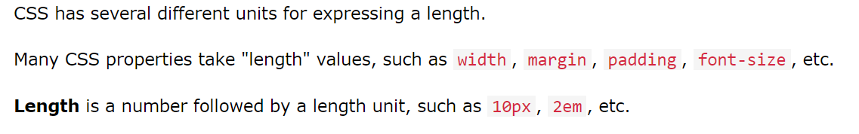
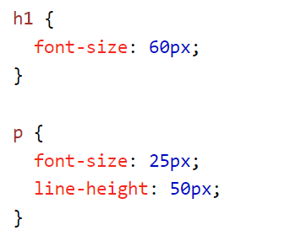
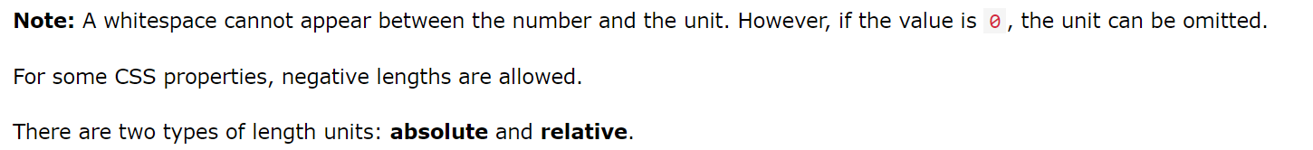
Units of Measurement

Slide 20
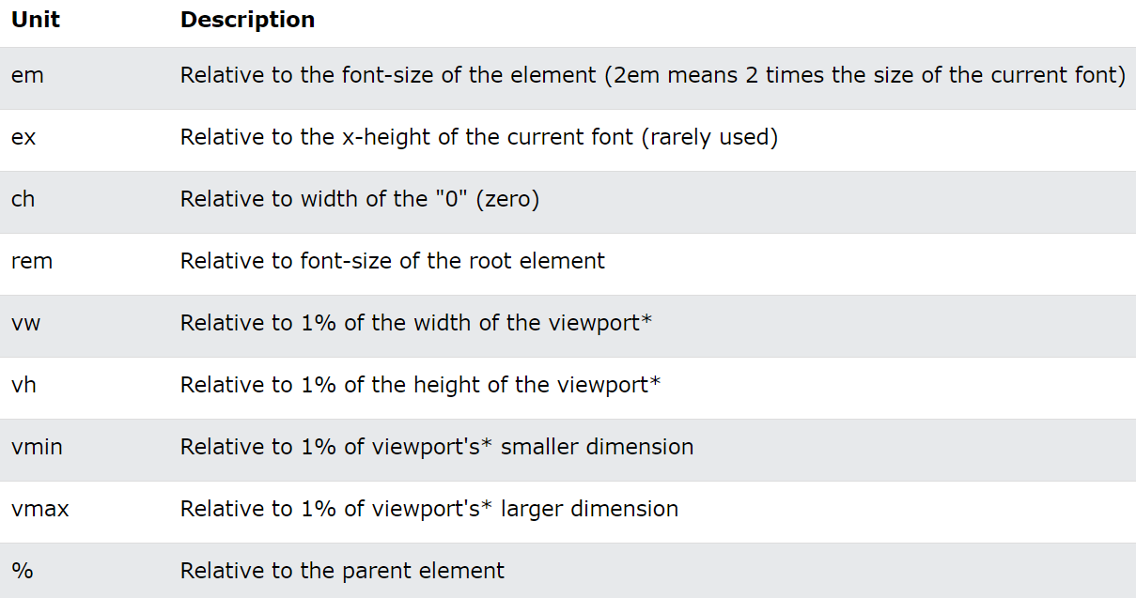
Relative Units

Slide 21
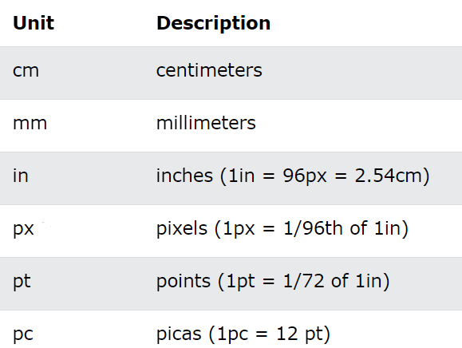
Absolute Units

Slide 22
Comments in CSS
It is often helpful to add comments to your style sheets. Comments take the form:
/* comment goes here */

Slide 23
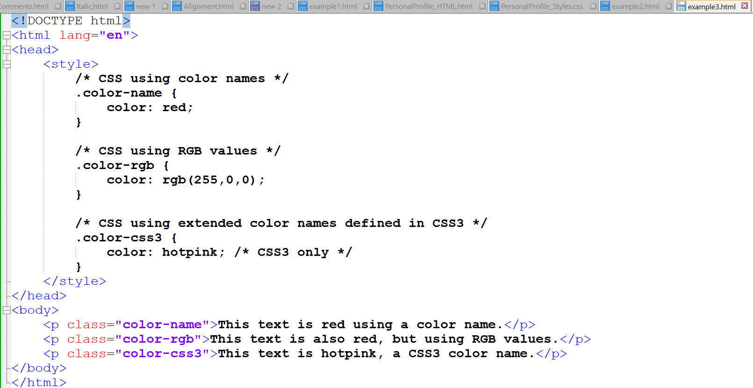
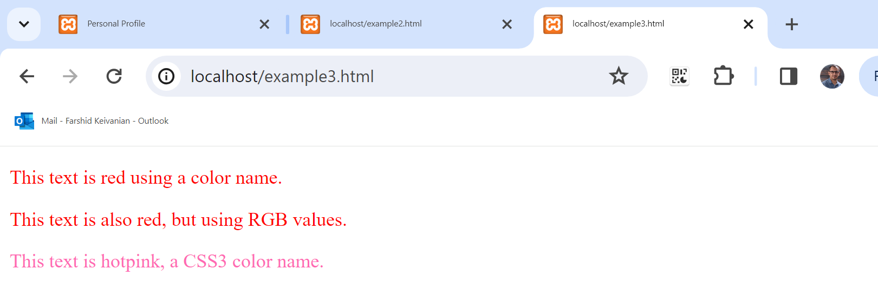
Example 3
In this example, three <p> elements are styled using different methods of specifying color in CSS. The first uses a basic color name, the second uses RGB numerical values, and the third uses one of the extended color names available in CSS3.

Slide 24
Three ways of inserting CSS…
External CSS: With an external style sheet, you can change the look of an entire website by changing just one file!
Each HTML page must include a reference to the external style sheet file inside the <link> element, inside the head section.
Internal CSS: An internal style sheet may be used if one single HTML page has a unique style.
The internal style is defined inside the <style> element, inside the head section.
Inline CSS: An inline style may be used to apply a unique style for a single element. To use inline styles, add the style attribute to the relevant element. The style attribute can contain any CSS property.

Slide 25
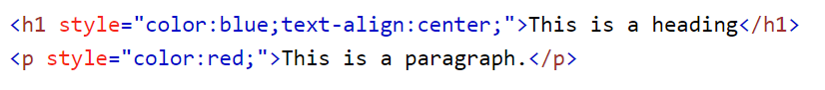
Inline Styles
An inline style only affects the element it is defined within and will override any other style definitions for the properties used in the inline style.
Using inline styles is generally discouraged since they increase bandwidth and decrease maintainability.
Inline styles can however be handy for quickly testing out a style change.

Slide 26
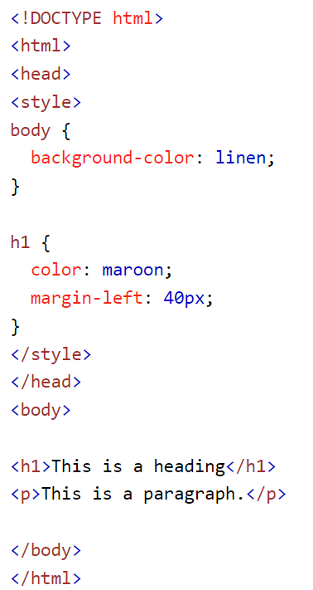
Internal Style Sheet
While better than inline styles, using embedded styles is also by and large discouraged.
Since each HTML document has its own <style> element, it is more difficult to consistently style multiple documents when using embedded styles.

Slide 27
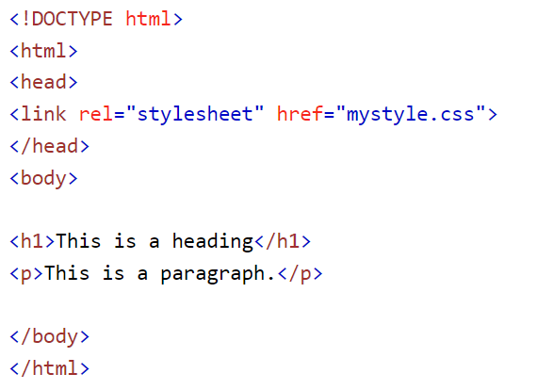
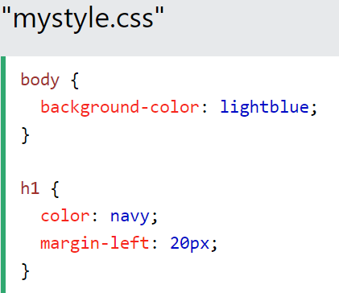
External Style Sheet
This is by far the most common place to locate style rules because it provides the best maintainability.
When you make a change to an external style sheet, all HTML documents that reference that style sheet will automatically use the updated version.
The browser is able to cache the external style sheet which can improve the performance of the site

Slide 28
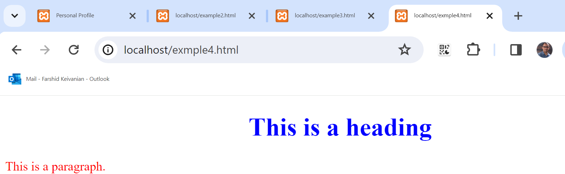
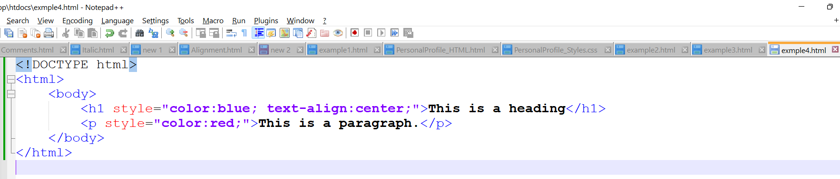
Example 4: Inline CSS: Directly within the HTML element (Not on GitHub, Please Type it)

Slide 29
Selectors
When defining CSS rules, you will need to use a selector to tell the browser which elements will be affected.
CSS selectors allow you to select
individual elemenets
multiple HTML elements,
elements that belong together in some way, or
elements that are positioned in specific ways in the document hierarchy.
There are a number of different selector types.

Slide 30
Element Selectors
Uses the HTML element name.
You can select all elements by using the universal element selector, which is the * (asterisk) character.

Slide 31
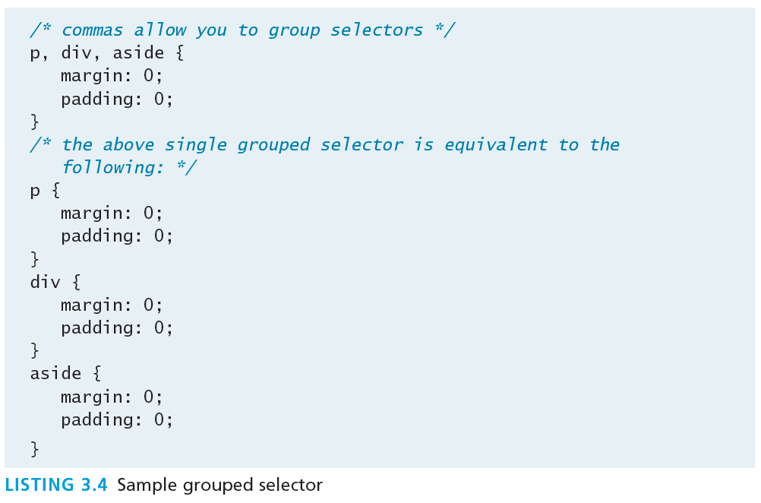
Grouped Selectors
You can select a group of elements by separating the different element names with commas.
This is a sensible way to reduce the size and complexity of your CSS files, by combining multiple identical rules into a single rule.

Slide 32
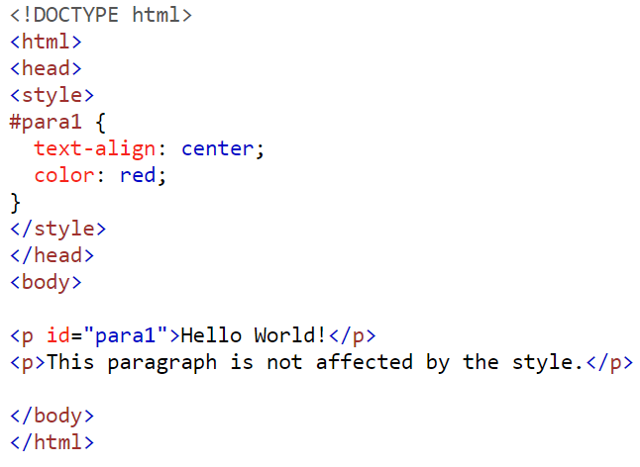
Id Selectors
An id selector allows you to target a specific element by its id attribute regardless of its type or position.
If an HTML element has been labeled with an id attribute, then you can target it for styling by using an id selector, which takes the form: pound/hash (#) followed by the id name.
Note: You should only be using an id once per page

Slide 33
Pseudo Selectors
A pseudo-element selector is a way to select something that does not exist explicitly as an element in the HTML document tree but which is still a recognizable selectable object.
A pseudo-class selector does apply to an HTML element, but targets either a particular state or, in CSS3, a variety of family relationships.
The most common use of this type of selectors is for targeting link states.

Slide 34
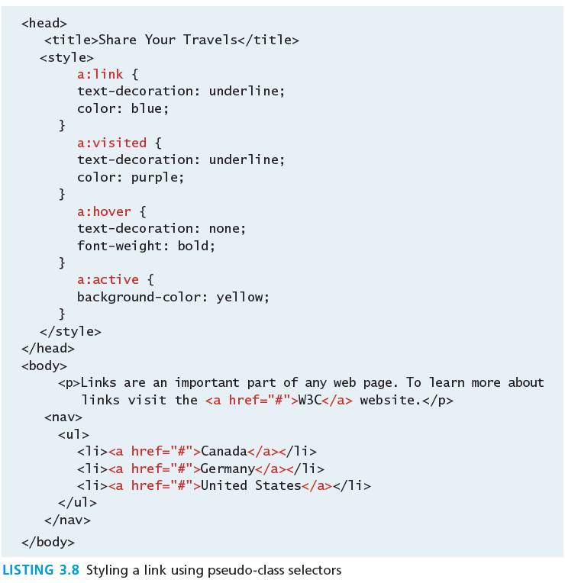
Pseudo Selectors

Slide 35
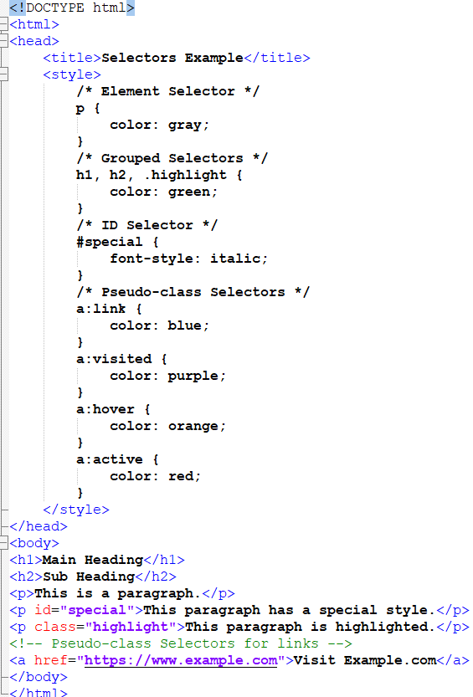
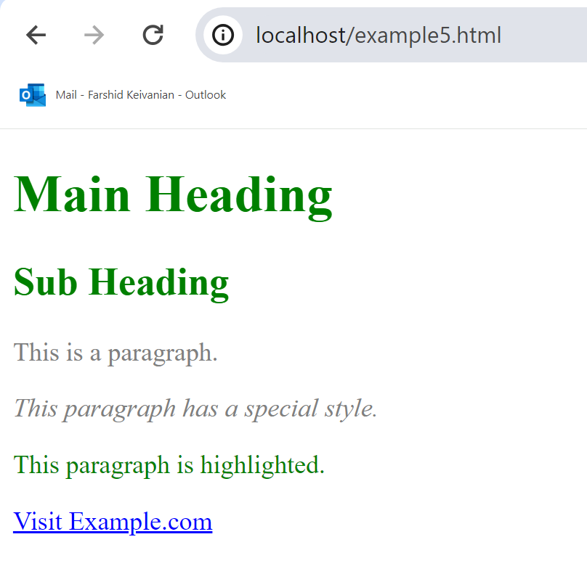
Example 5: Let's create a simple HTML and CSS example to demonstrate different types of selectors, including element, grouped, ID, and pseudo-class selectors.

Slide 36
Example 5: Let's create a simple HTML and CSS example to demonstrate different types of selectors, including element, grouped, ID, and pseudo-class selectors.
The element selector p styles all <p> elements.
The grouped selector h1, h2, .highlight styles all <h1>, <h2> elements, and elements with the class .highlight.
The ID selector #special styles the element with the ID special.
The pseudo-class selectors a:link, a:visited, a:hover, and a:active style anchor (<a>) elements based on their state (unvisited, visited, when the mouse is over them, and when they are being clicked, respectively).

Slide 37
The Box Model
In CSS, all HTML elements exist within an element box.
It is absolutely essential that you familiarize yourself with the terminology and relationship of the CSS properties within the element box.

Slide 38
The Box Model

Slide 39
Background
The background color or image of an element fills an element out to its border (if it has one that is).
In contemporary web design, it has become extremely common too use CSS to display purely presentational images (such as background gradients and patterns, decorative images, etc) rather than using the <img> element.

Slide 40
Background Properties
Property | Description
background | A combined short-hand property that allows you to set the background values in one property. While you can omit properties with the short-hand, do remember that any omitted properties will be set to their default value.
background-attachment | Specifies whether the background image scrolls with the document (default) or remains fixed. Possible values are: fixed, scroll.
background-color | Sets the background color of the element.
background-image | Specifies the background image (which is generally a jpeg, gif, or png file) for the element. Note that the URL is relative to the CSS file and not the HTML. CSS3 introduced the ability to specify multiple background images.

Slide 41
Background Properties
background-position | Specifies where on the element the background image will be placed. Some possible values include: bottom, center, left, and right. You can also supply a pixel or percentage numeric position value as well. When supplying a numeric value, you must supply a horizontal/vertical pair; this value indicates its distance from the top left corner of the element.

Slide 42
Background Properties
background-repeat | Determines whether the background image will be repeated. This is a common technique for creating a tiled background (it is in fact the default behavior). Possible values are: repeat, repeat-x, repeat-y, and no-repeat.
background-size | New to CSS3, this property lets you modify the size of the background image.

Slide 43
Background Repeat

Slide 44
Background Position

Slide 45
Borders
Borders provide a way to visually separate elements.
You can put borders around all four sides of an element, or just one, two, or three of the sides.

Slide 46
Borders
Property | Description
border | A combined short-hand property that allows you to set the style, width, and color of a border in one property. The order is important and must be: border-style border-width border-color
border-style | Specifies the line type of the border. Possible values are: solid, dotted, dashed, double, groove, ridge, inset, and outset.

Slide 47
Borders
border-width | The width of the border in a unit (but not percents). A variety of keywords (thin, medium, etc) are also supported.
border-color | The color of the border in a color unit.
border-radius | The radius of a rounded corner.
border-image | The URL of an image to use as a border.

Slide 48
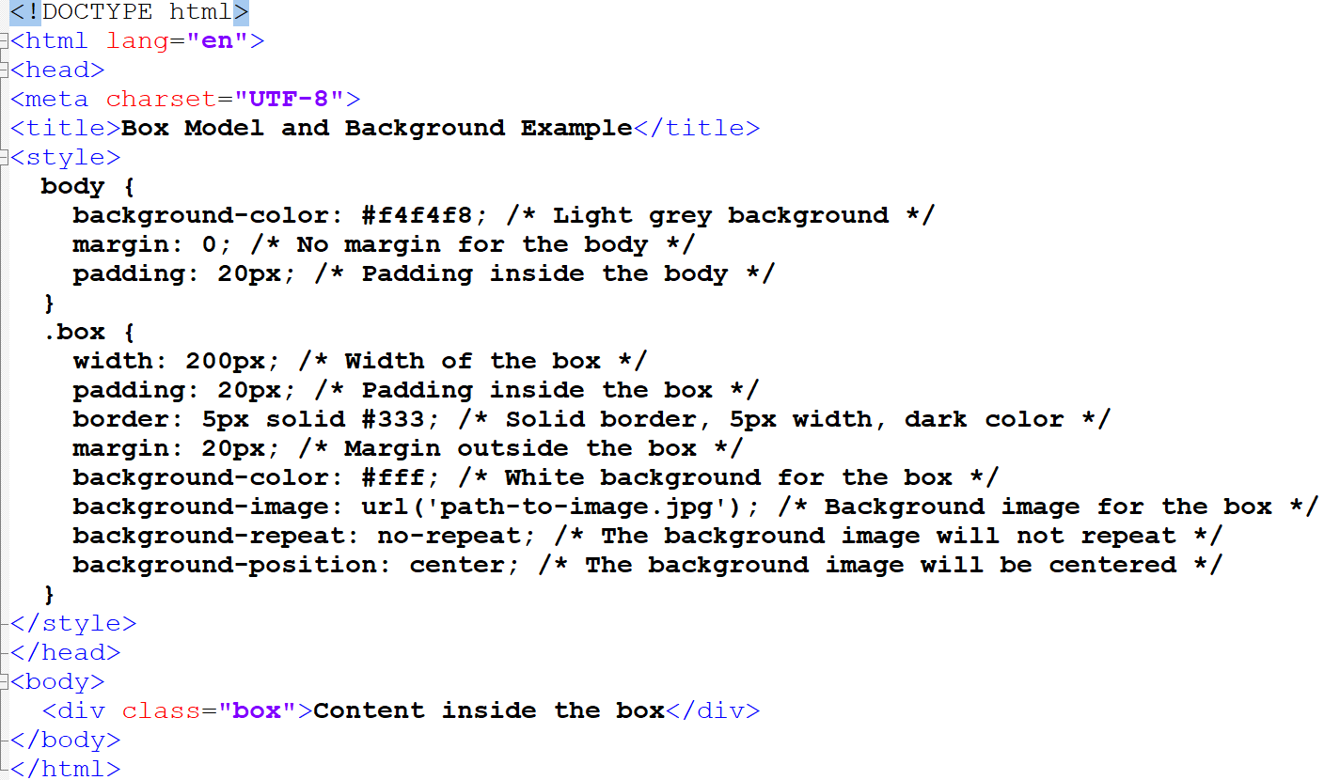
Example 6:
This code provides a complete HTML document with internal CSS. The .box class demonstrates the CSS box model by setting width, padding, border, and margin. Additionally, it includes background-color, background-image, background-repeat, and background-position to illustrate how background properties can be used.

Slide 49
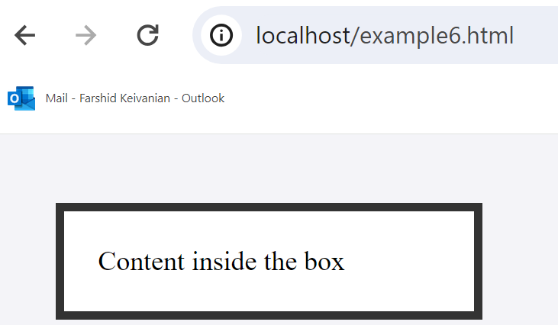
Example 6:

Slide 50
Margins and Padding

Slide 51
Margins
Did you notice that the space between paragraphs one and two and between two and three is the same as the space before paragraph one and after paragraph three?
This is due to the fact that adjoining vertical margins collapse.

Slide 52
Width and Height
The width and height properties specify the size of the element’s content area.
Perhaps the only rival for collapsing margins in troubling our students, box dimensions have a number of potential issues.

Slide 53
Width and Height
Only block-level elements and non-text inline elements such as images have a width and height that you can specify.
By default the width of and height of elements is the actual size of the content.
For text,
this is determined by the font size and font face;
For images,
the width and height of the actual image in pixels determines the element box’s dimensions.

Slide 54
Width and Height

Slide 55
Text Properties
CSS provides two types of properties that affect text.
font properties that affect the font and its appearance.
paragraph properties that affect the text in a similar way no matter which font is being used.

Slide 56
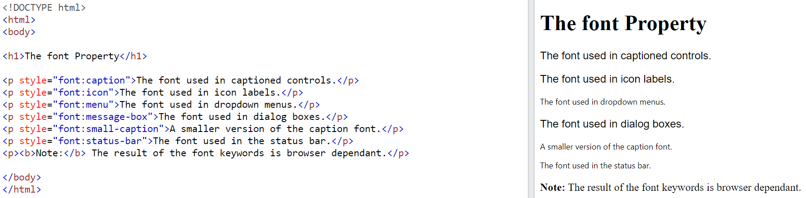
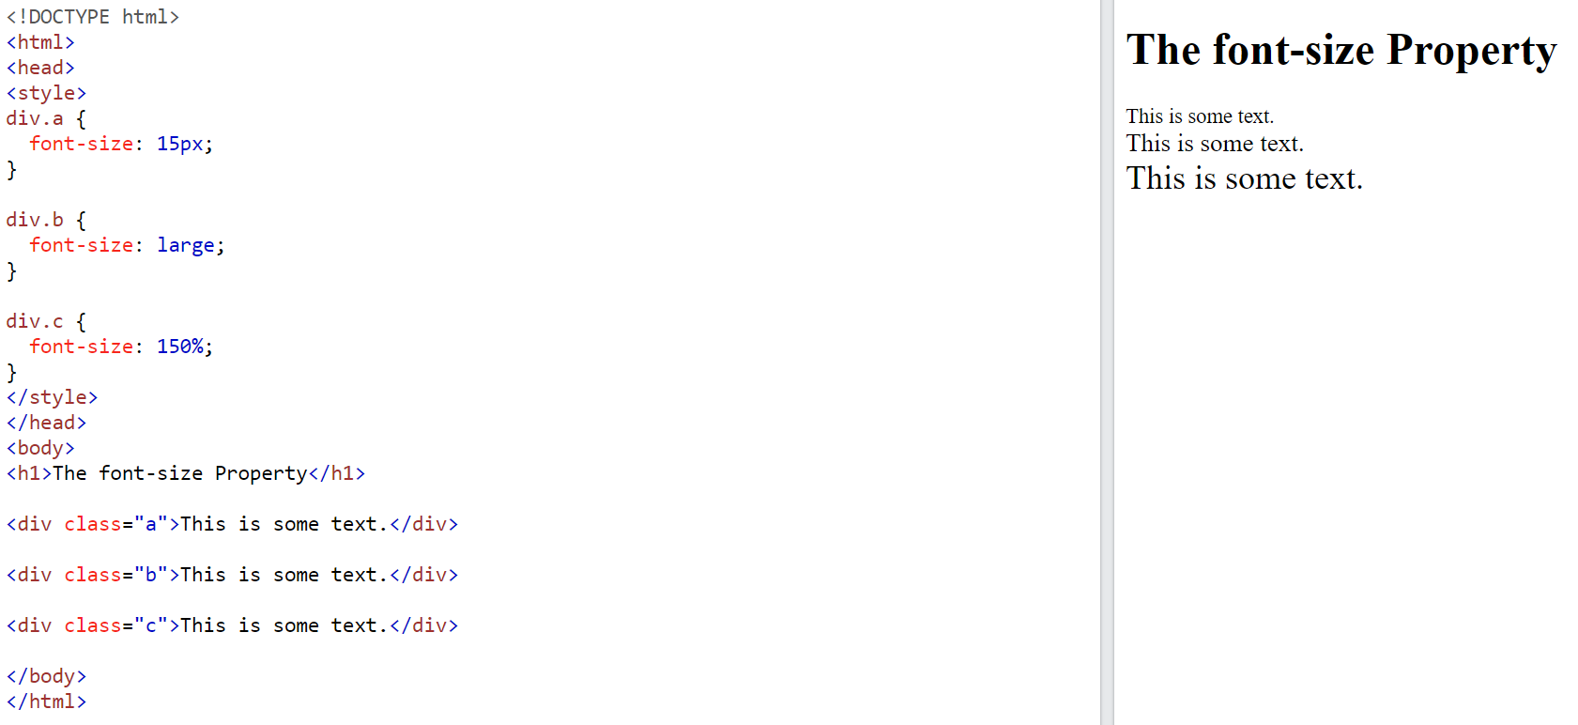
Text Properties

Slide 57
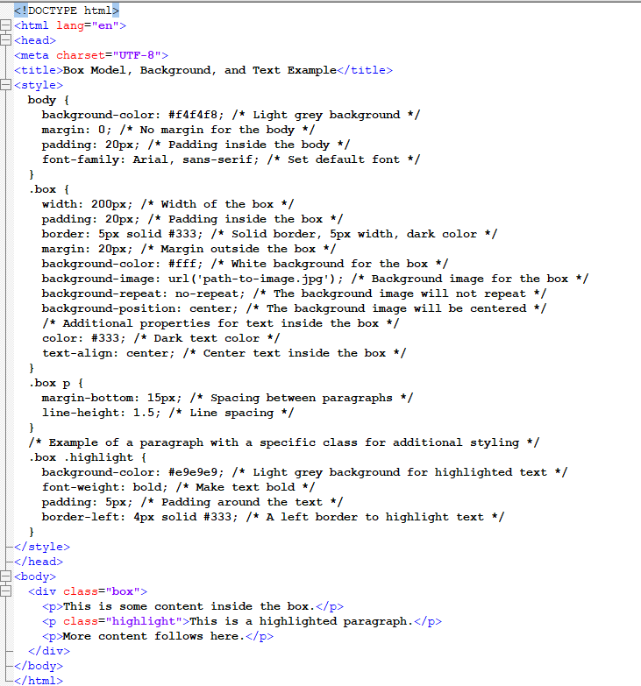
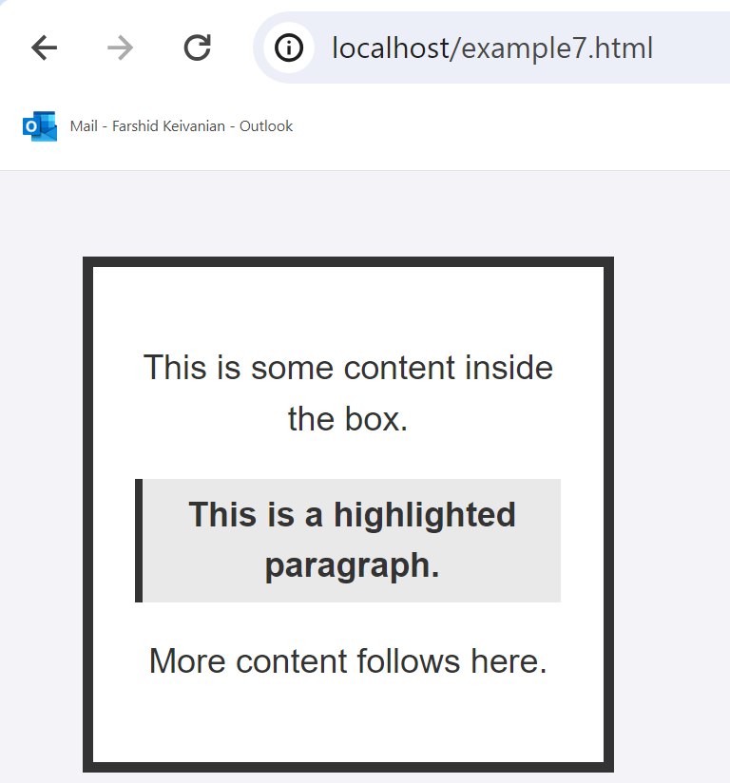
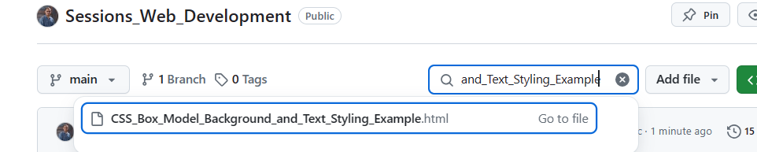
Example 7:
Let's integrate the concepts of borders, margins, padding, and text properties into your provided HTML/CSS example. We already have a .box class that sets these properties for a div element.

Slide 58
Example 7:
To incorporate additional styling for text within this box, you can either add a new class or directly target the child elements (like p for paragraphs) inside the .box class.

Slide 59
2. Attendance & Multiple-Choice Questions - Recognising student participation and engagement specifically identifying those who are most actively

Slide 60
Question 1: What is the purpose of using an external CSS style sheet?
A) To style each HTML element differently without reusing any styles
B) To enable the inline styling of HTML documents
C) To change the look of an entire website by changing just one file
D) To increase the loading time of webpages
Correct Answer: C - External CSS allows changes across the entire website by editing one file, promoting consistency and maintainability.
Question 2: Which CSS property is used to change the text color of an element?
A) font-style
B) text-align
C) color
D) text-decoration
Correct Answer: C - The 'color' property is specifically used to define the text color of an HTML element.

Slide 61
Question 3: What does the 'border-collapse' property do in a CSS rule for 'table'?
A) Increases the distance between borders of adjacent cells
B) Creates a double border with some space between the two borders
C) Collapses the borders between table cells into a single border
D) Removes all borders from the table
Correct Answer: C - The 'border-collapse' property is used to collapse the borders between table cells into one single border, which simplifies the styling and appearance of the table.

Slide 62
3. Tutorial/Preparation for Weekly Lab Submission

Slide 63
Tutorial Week 4
The objective of the exercise today is to evaluate your HTML and CSS knowledge that you have obtained so far.
Create a personal webpage that is considered as your profile. You will have paragraphs to explain about yourself. A table to explain you timetable with SISTC. Make your design professional using internal, external, inline CSS for any selector.
Add the HTML/CSS code of your webpage here followed by the screenshot of your webpage.

Slide 64
Let's put together an HTML/CSS code snippet that represents a personal profile webpage. This page will contain a brief self-description, a timetable, and demonstrate the use of internal, external, and inline CSS.

Slide 65
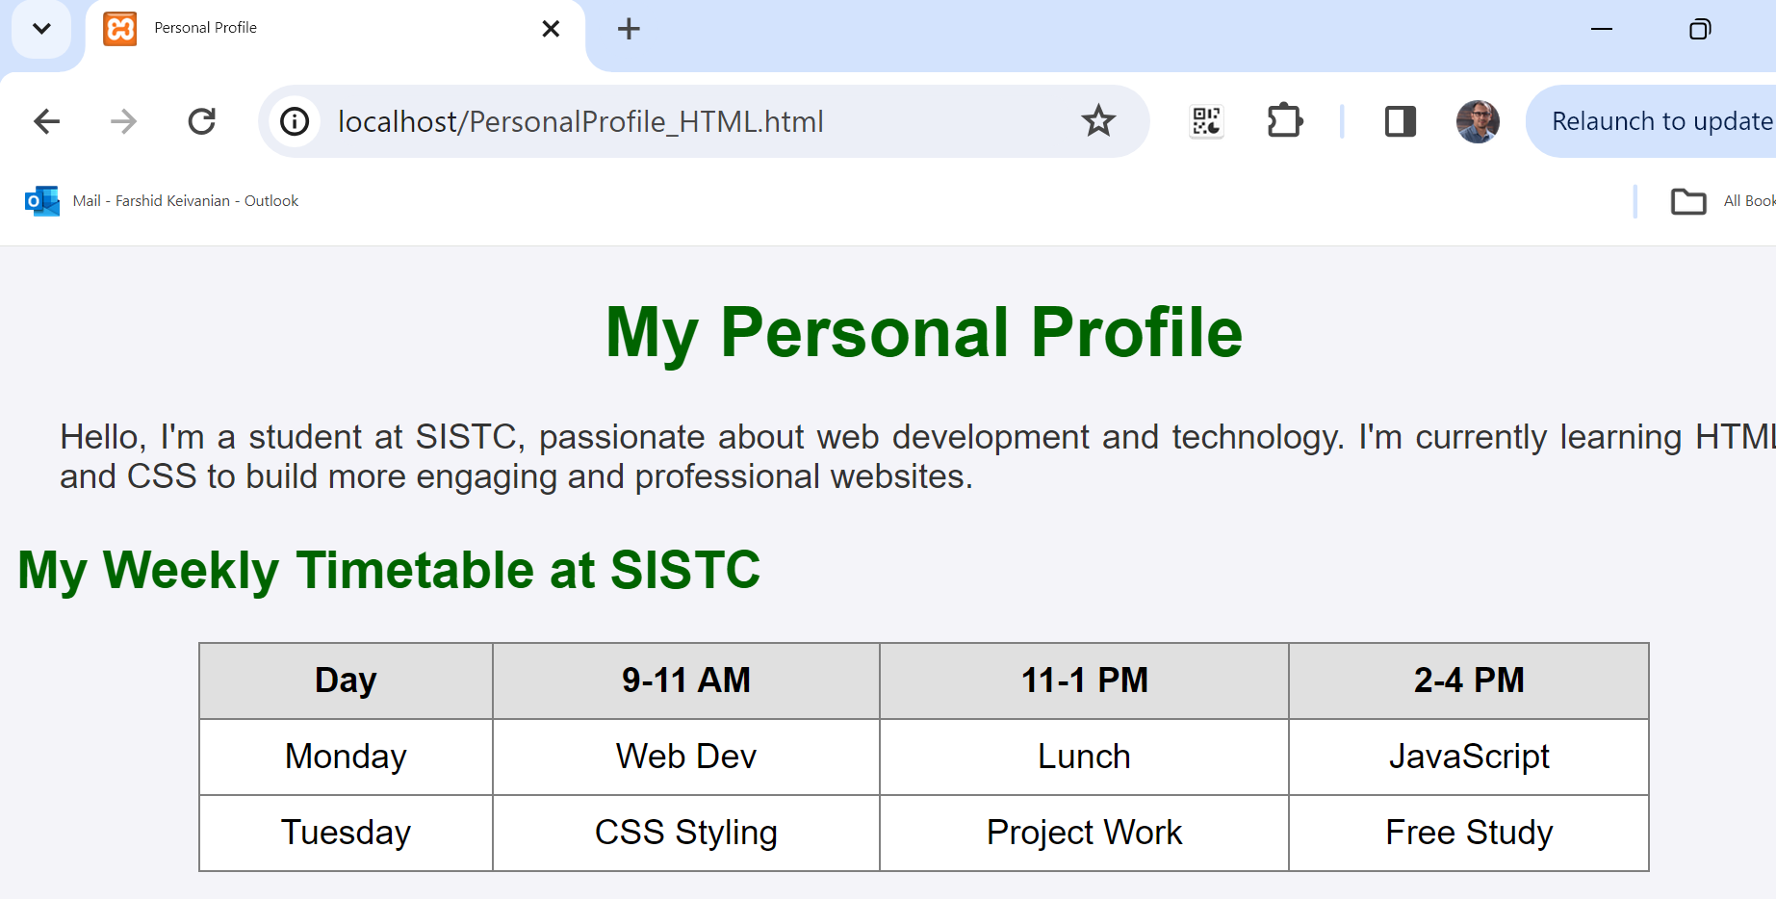

Slide 66
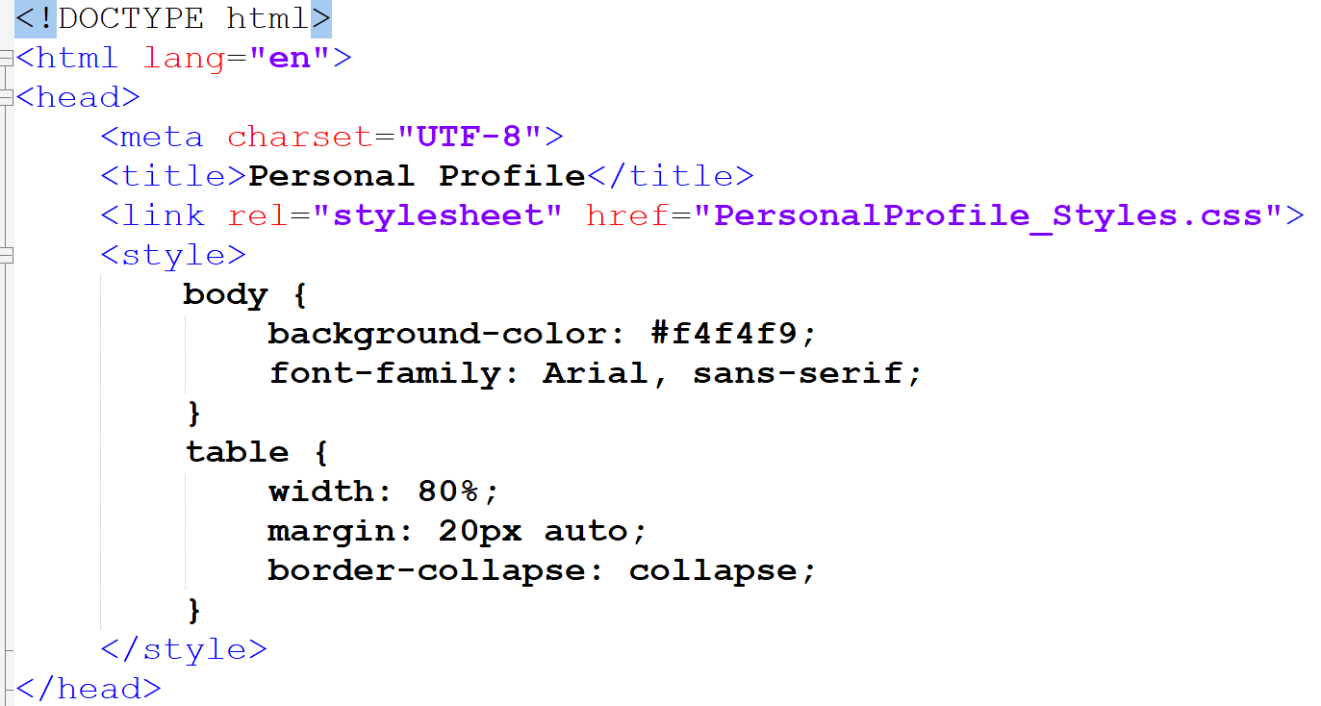
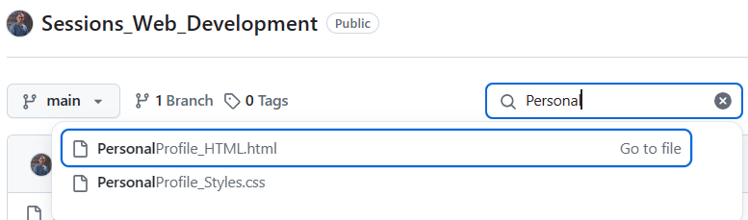
This is a style block within the HTML document's <head> section. It defines CSS rules for the <body> and <table> HTML elements:
body { ... }: This rule applies to the whole webpage's body.
background-color: #f4f4f9;: Sets the background color to a very pale blue (almost white). This color fills the entire page behind any other content.

Slide 67
font-family: Arial, sans-serif;: Sets the default font for the text in the body to Arial. If Arial isn't available, it falls back to any available sans-serif font. Sans-serif fonts do not have the small projecting features called "serifs" at the end of strokes.

Slide 68
table { ... }: This rule applies to all <table> elements in the document.
width: 80%;: The table width will be 80% of the width of its containing element, often the body or a div, which helps in making a responsive design.
margin: 20px auto;: Centers the table on the page by setting the top and bottom margins to 20px and the left and right margins to 'auto', which automatically balances them.

Slide 69
border-collapse: collapse;: This property collapses the borders between table cells, making it so that there's no space between cell borders.
These CSS rules directly affect how the webpage is presented to the user in terms of color, typography, and the layout of tabular data.

Slide 70
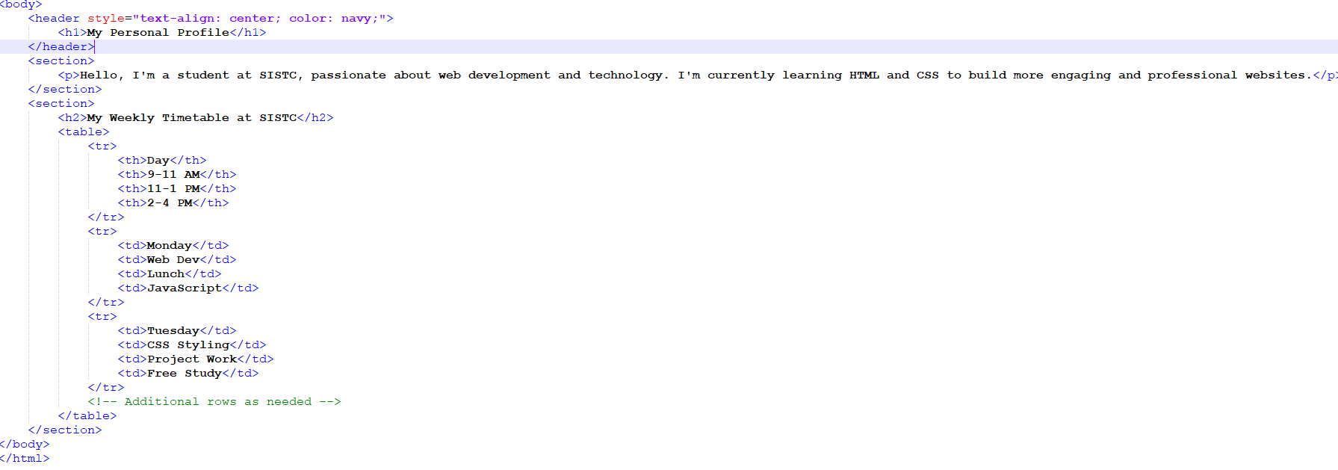
<body>: This tag represents the content of the HTML document that will be displayed in the browser window. Everything inside this tag is part of the document's content.
<header>: The header element typically contains introductory content or a set of navigational links. In this case, it contains a heading.
style="text-align: center; color: navy;": This inline CSS style aligns the text inside the header to the center and sets the color of the text to navy blue.

Slide 71
<h1>My Personal Profile</h1>: An h1 heading is usually the title or a high-level heading on the page. Here it's used for the title of the personal profile section.
<section>: This tag defines a section in a document. It's used to group thematic content, and it often includes one or more headings.
The first <section> contains a paragraph <p> that introduces the user as a student learning web development.
The second <section> starts with a heading <h2> titled "My Weekly Timetable at SISTC" and includes a table that outlines the user's weekly schedule.

Slide 72
<table>: The table is used to display tabular data in rows and columns.
<tr>: Table row element, each tr represents a row of cells in the table.
<th>: Table header cell, provides header text for a column. This row is typically styled differently from regular cells to differentiate it as a header.
<td>: Table data cell, contains the data for one cell of the table.
In summary, this portion of the code presents a personal profile with a title and introductory paragraph and then displays a weekly timetable in a table format. This structured presentation helps users quickly understand the main points of the profile and the schedule.

Slide 73
These codes can be used in HTML or CSS to specify colors in digital designs. Each color code is provided in hexadecimal format, which is commonly used in web design:
Red: #FF0000 - A vibrant, primary red.
Green: #00FF00 - A bright, pure green.
Blue: #0000FF - A deep, primary blue.
White: #FFFFFF - Pure white.
Black: #000000 - Absolute black.
Yellow: #FFFF00 - A bright, sunny yellow.
Cyan (Aqua): #00FFFF - A mix of green and blue, creating cyan.
Magenta (Fuchsia): #FF00FF - A deep pink-purple color, combining red and blue.
Silver: #C0C0C0 - A metallic gray, lighter than gray.
Gray: #808080 - A perfect midpoint between black and white.
Maroon: #800000 - A dark red.
Olive: #808000 - A dark shade of yellow-green.
Purple: #800080 - A deep purple, close to violet.
Teal: #008080 - A dark greenish-blue.
Navy: #000080 - A very dark blue, almost black.
Change the code based on your personal information/preferences

Slide 74
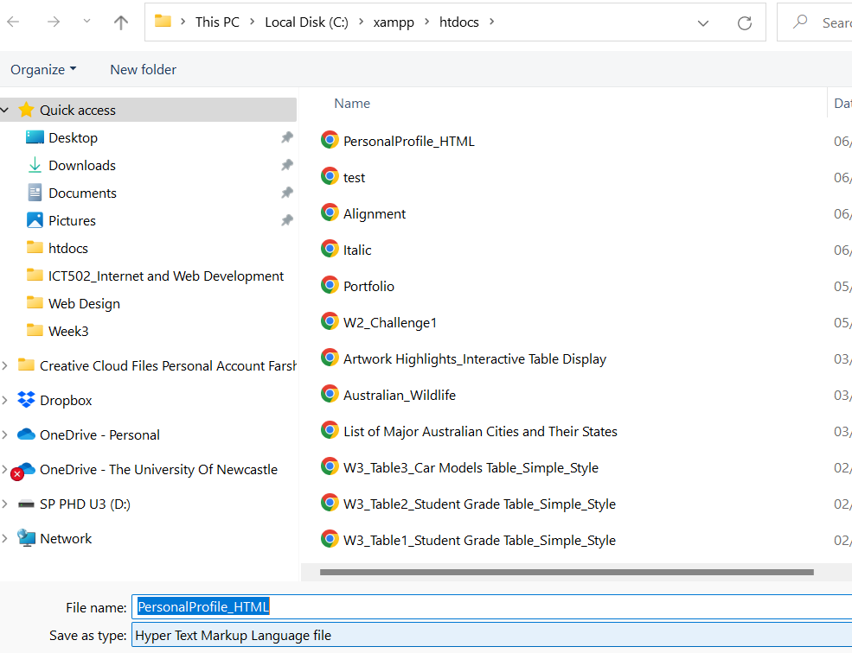
HTML and CSS Code for the Profile Webpage (Ctrl + Alt + S)
Change the code based on your personal information/preferences

Slide 75
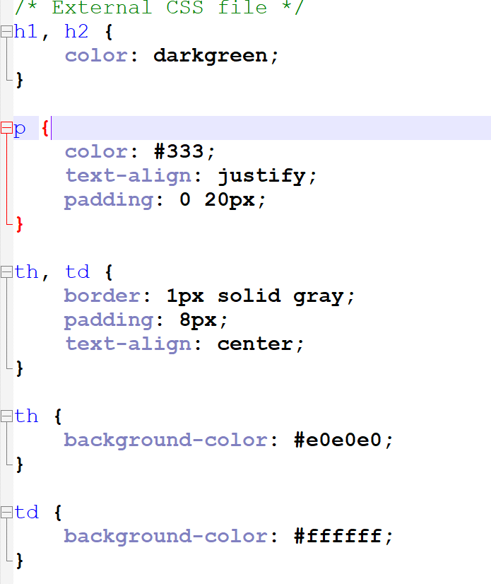
h1, h2 { ... }:
This rule targets both h1 and h2 HTML elements (headings).
color: darkgreen;: Sets the text color of these headings to dark green.

Slide 76
p { ... }:
This rule targets p HTML elements (paragraphs).
color: #333;: Sets the text color of paragraphs to a dark gray (hex code #333 is shorthand for #333333).
text-align: justify;: Aligns the text in paragraphs so that it is spread out to fill the line width, creating a clean look with both left and right edges aligned.
padding: 0 20px;: Applies padding of 0 on the top and bottom and 20 pixels on the left and right sides of paragraphs. This adds space inside the paragraph element between the text and the element's border.

Slide 77
th, td { ... }:
This rule targets th (table header cells) and td (table data cells) HTML elements.
border: 1px solid gray;: Adds a solid gray border of 1 pixel around each cell.
padding: 8px;: Applies padding of 8 pixels inside each cell, creating space between the cell border and its content.
text-align: center;: Centers the text horizontally within the header and data cells.

Slide 78
th { ... }:
This rule specifically targets th HTML elements.
background-color: #e0e0e0;: Sets the background color of table header cells to a light gray.

Slide 79
td { ... }:
This rule specifically targets td HTML elements.
background-color: #ffffff;: Sets the background color of table data cells to white.
These styles together create a visually consistent and readable table, with clear distinctions between headers and data cells, and nicely formatted text for both headings and paragraphs.

Slide 80
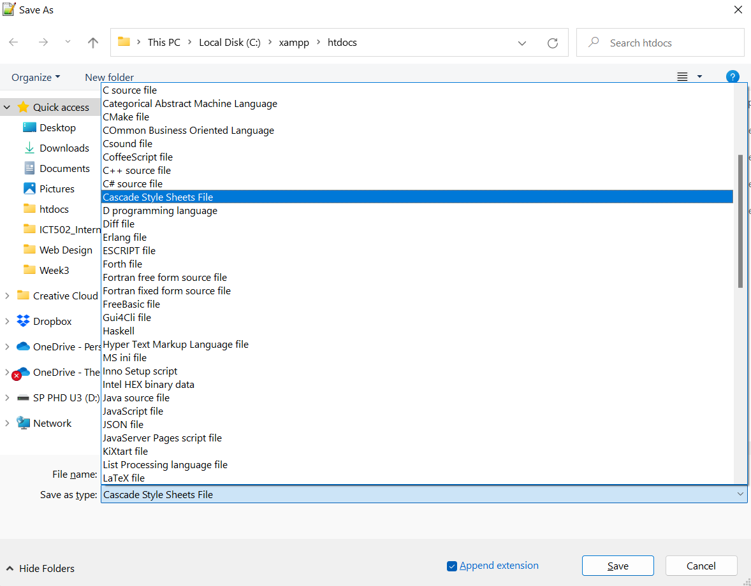
HTML and CSS Code for the Profile Webpage (Ctrl + Alt + S)
Change the code based on your personal information/preferences

Slide 81
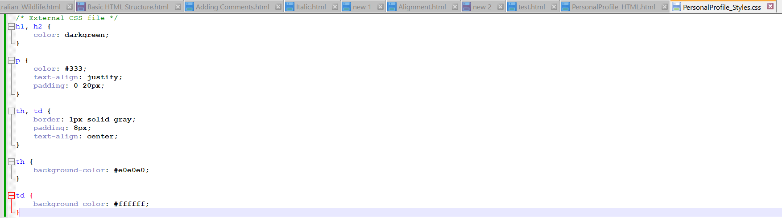

Slide 82


Slide 83


Slide 84
Happy A Learning Day, Dr. Farshid Keivanian

